Slide 1

Diabetes Prediction with Artificial Neural Networks
Diabetes is a growing global health concern, affecting millions worldwide. Early detection and effective prevention strategies are crucial. This presentation explores how Artificial Neural Networks (ANNs), a powerful machine learning tool, can be leveraged to predict and manage this chronic condition.
-Lavanya kethavath 21911A3527

Slide 2
Understanding the Diabetes Dataset
1
Comprehensive Data
2
Key Features
3
Targeted Prediction
The dataset includes factors such as pregnancy history, glucose levels, blood pressure, and body mass index, which are important indicators of diabetes risk.
The goal is to use this data to accurately predict whether an individual has diabetes or not, enabling early intervention and prevention.
The Pima Indians Diabetes Database contains 768 records with 8 features and 1 target variable, providing a robust dataset for analysis.

Slide 3
Preprocessing the Data
Handling Missing Values
Feature Scaling
Train-Test Split
Features were standardized using the StandardScaler to ensure that they are on a similar scale, improving the model's performance.
The dataset was divided into 80% for training and 20% for testing, allowing for robust model evaluation and generalization.
Missing values were replaced with the mean or median values to ensure a complete dataset for training the model.

Slide 4
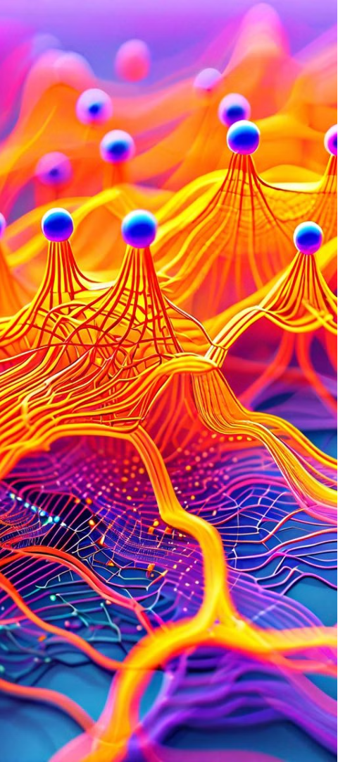
Designing the ANN Model
1
Network Architecture
The ANN model was designed with 2 hidden layers, containing 16 and 8 neurons, respectively, to capture the complex relationships in the data.
2
Activation Functions
The ReLU function was used in the hidden layers, while the sigmoid function was chosen for the output layer to predict the binary diabetes status.
3
Optimization and Loss
The Adam optimizer with a learning rate of 0.001 was used, and the binary cross-entropy loss function was selected to train the model effectively.

Slide 5
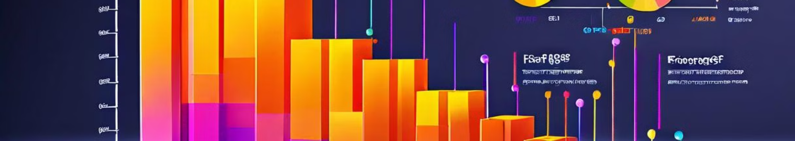
Training and Evaluating the ANN Model
Training Details
Performance Metrics
Practical Application
The model was trained for 100 epochs with a batch size of 32, ensuring efficient and effective learning.
The model achieved an accuracy of 0.83, precision of 0.84, recall of 0.82, F1-score of 0.83, and ROC-AUC of 0.87, demonstrating its strong predictive capabilities.
The high-performance metrics indicate that the ANN model can be effectively utilized for early diabetes detection and prevention, supporting healthcare professionals in their decision-making process.

Slide 6
Analyzing the Confusion Matrix
1
True Positives
2
False Positives
The model correctly identified 134 individuals as having diabetes, allowing for timely intervention and management.
23 individuals were incorrectly predicted to have diabetes, highlighting the need for further clinical evaluation to confirm the diagnosis.
3
True Negatives
4
False Negatives
The model accurately identified 141 individuals as not having diabetes, reducing unnecessary medical procedures and costs.
20 individuals were mistakenly predicted as not having diabetes, emphasizing the importance of continued monitoring and regular check-ups.

Slide 7



Visualizing the ROC-AUC Curve
High AUC-ROC Score
Accurate Predictions
Potential for Improvement
The model achieved an AUC-ROC score of 0.87, indicating its strong ability to distinguish between positive and negative cases.
The ROC-AUC curve demonstrates the model's high level of accuracy in predicting diabetes, making it a valuable tool for healthcare professionals.
While the model's performance is strong, there may be opportunities to further refine the architecture and hyperparameters to enhance its predictive capabilities.

Slide 8




Conclusion
Effective Prediction
Early Intervention
Future Improvements
The ANN model achieved a high accuracy in predicting diabetes, showcasing the power of machine learning in healthcare applications.
The model can be used as a tool for early detection and prevention of diabetes, allowing healthcare professionals to provide timely and targeted treatment.
Continued research and refinement of the model, including exploring different algorithms and feature engineering, can further enhance its predictive capabilities.

Slide 9
THANK YOU..!
Presented by: Lavanya Kethavath 21911A3527 AI-A (3yr-2)

